Slide 1


Audio-Only Detection
Soccer Events (ELEC5305)
Marcellus Ray Gunawan - 520038655

Slide 2
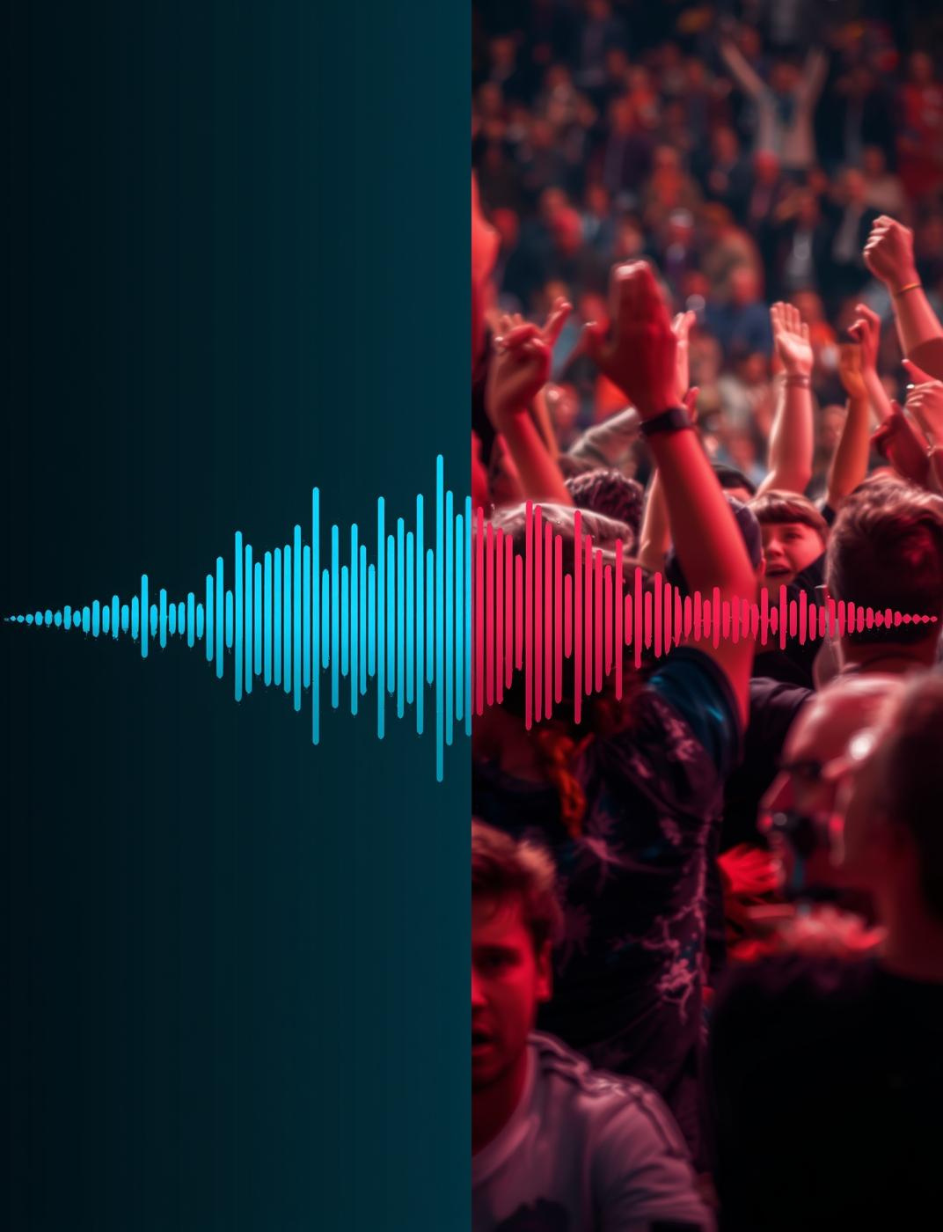
Why Audio?
Audio offers low-latency detection and captures essential information, complementary video technologies to enhance event understanding.

Slide 3
Research Question
Exploring audio-only event detection capabilities
This study investigates whether audio alone can effectively detect soccer events, comparing the performance of RNN, Wav2Vec2, and AST models in achieving accurate predictions.

Slide 4
Dataset & Labels
EPL Subset
Six Classes
Half-Level Splits
Focused on popular English Premier League matches.
Includes events like fouls and throw-ins.
Data is split for fair evaluation and training.

Slide 5
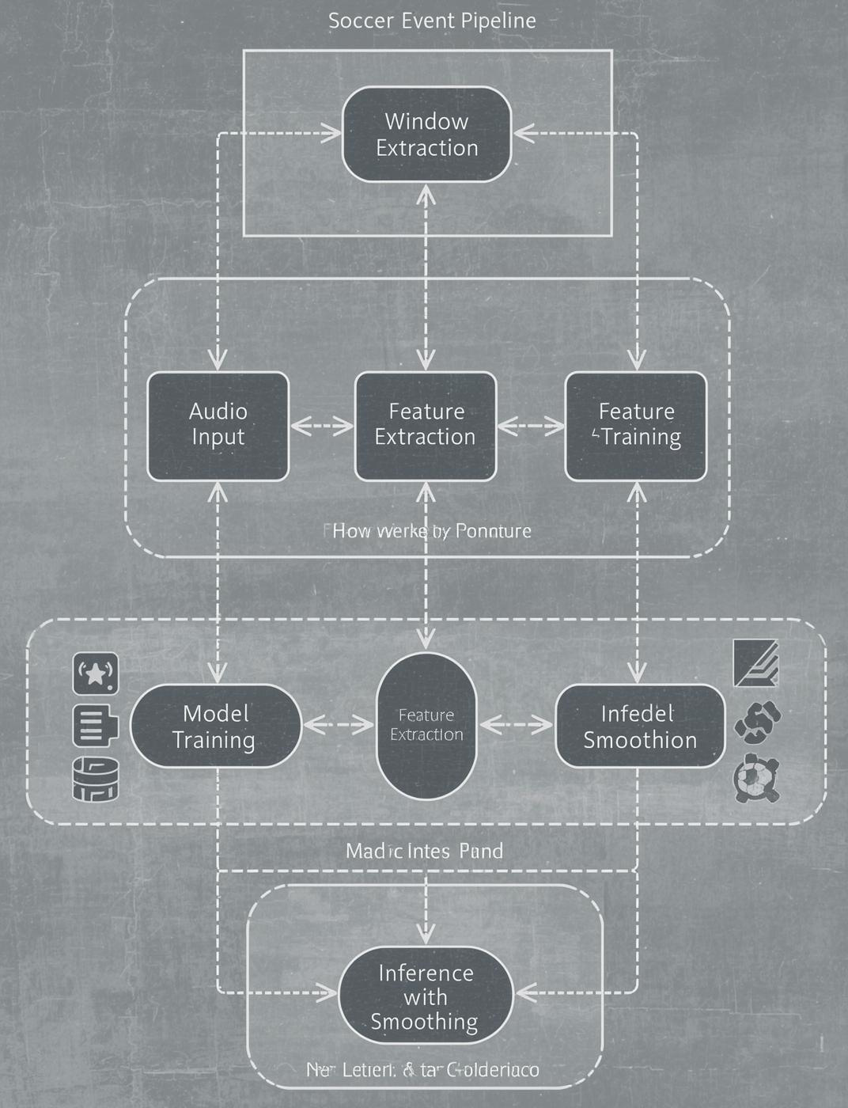
Pipeline Overview
This pipeline outlines the process from window extraction to feature modeling and final inference, ensuring robust performance.

Slide 6
Features & Windows
Exploring audio representation techniques
This section discusses using log-mel spectrograms and W2V2 waveforms, examining trade-offs between 15s and 30s windows for improved event detection performance.

Slide 7
Model Comparison
Evaluating different audio models
RNN Architecture
Wav2Vec2 Model
AST Approach
The RNN model utilizes 2×BiGRU layers, effectively capturing sequential patterns in audio data, crucial for recognizing soccer events amidst complex soundscapes.
The Wav2Vec2 model is applied in a frozen + head configuration, leveraging pretrained features to enhance event detection without extensive training time on the soccer dataset.
The AST model explores head-only vs partial fine-tuning, showcasing its ability to adapt to audio nuances, significantly improving detection performance in the context of soccer events.

Slide 8
Training & Evaluation
Ensuring Fairness in Model Assessment
Our approach utilizes class-weighted cross-entropy loss, Adam/AdamW optimizers, and Macro-F1 metrics to guarantee fair evaluation across models, alongside confusion and precision-recall curves for deeper insights.

Slide 9
Validation Results
The results indicate significant disparities among models, with AST(FT) achieving the highest accuracy and Macro-F1 score.
Model | Accuracy | F1 | Notes
RNN Baseline | 2.3% | 0.5 | High class imbalance impact
Wav2Vec2 | 23% | 0.25 | Pretrained, frozen layers
AST | 42% | 0.45 | Pretrained, frozen layers
AST (FT) | 55% | 0.53 | AudioSet weights, tuned

Slide 10
Why AST(FT) Wins
Key advantages of AST(FT) model
Pretraining Benefits
Contextual Awareness
Domain Adaptation
AudioSet pretraining significantly enhances the model's ability to recognize non-speech audio signals, providing a robust foundation for detecting various soccer events.
Patch attention mechanisms allow AST(FT) to capture important contextual information, improving its performance in distinguishing between similar audio events during a soccer match.
The partial fine-tuning of AST(FT) effectively adapts the model to the specific characteristics of soccer audio, leading to improved accuracy in event detection.

Slide 11
Error Patterns
Understanding Detection Challenges in Soccer Events
Key challenges include confusing throw-ins and ball-outs, class imbalance, and variability in loudness from commentary, all affecting accurate detection performance in audio analysis.

Slide 12

Future Improvements
01
Focal Loss
Using focal loss can improve class imbalance handling.
02
Multi-Scale Windows
Implementing multi-scale windows enhances temporal feature extraction.
03
Smoothing Techniques
HMM/CRF smoothing will refine event detection accuracy.

Slide 13
01
Low-latency
Enables near-instant highlight selections for broadcasted matches.
Impact and Use-Cases
02
Redundancy
Complements video feeds, enhancing coverage of critical moments.
03
Scalability
Designed to operate efficiently on limited computing resources.

Slide 14


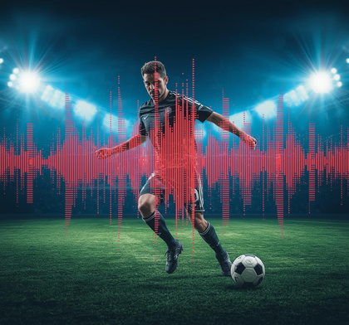


Key Takeaways from Audio-Only Detection
Feasibility
Improvements
Audio-only detection is viable and effective.
Various methods can enhance detection accuracy.
Performance
Future Work
AST(FT) outperforms other models significantly.
Clear paths for ongoing system enhancements.

Slide 15
References
Key datasets and resources used
This presentation utilized pivotal resources, including SoccerNet V1/V2, Echoes, AST, Wav2Vec2, and AudioSet, for comprehensive audio event detection analysis and findings.

